Slide 1
Blender Made Me Age 5 Years
By Rev Guarino

Slide 2
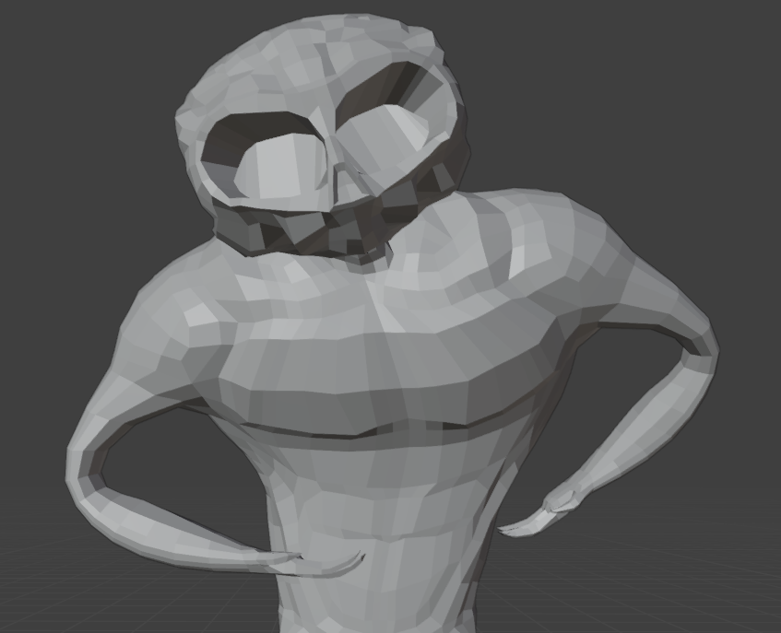
Inspiration
Originally, none.
Then, some. I wanted to make a spooky fleshy skeleton man.
Then, with the power of spite. I fixed my spooky fleshy skeleton man and made him a hunk.
(Insert Johnny Bravo Line)

Slide 3
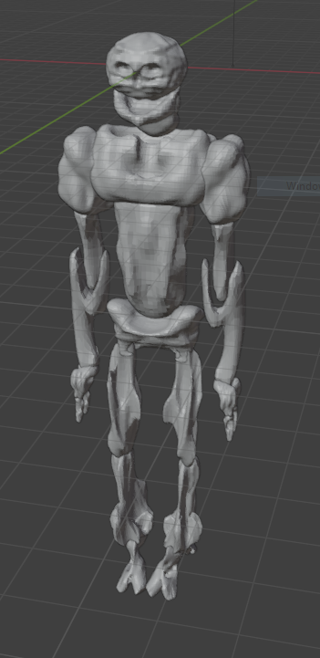
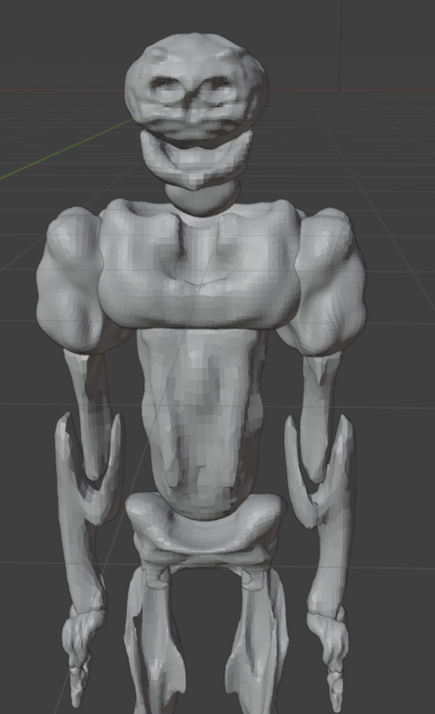
Block Out
As you can see, I had a clear understanding of how to block out.
I would like to black out my block out phase from my memory.
I skipped this step for the second version. I found it much easier to just draw my meshes, but I also find everything closer to programming easier.

Slide 4
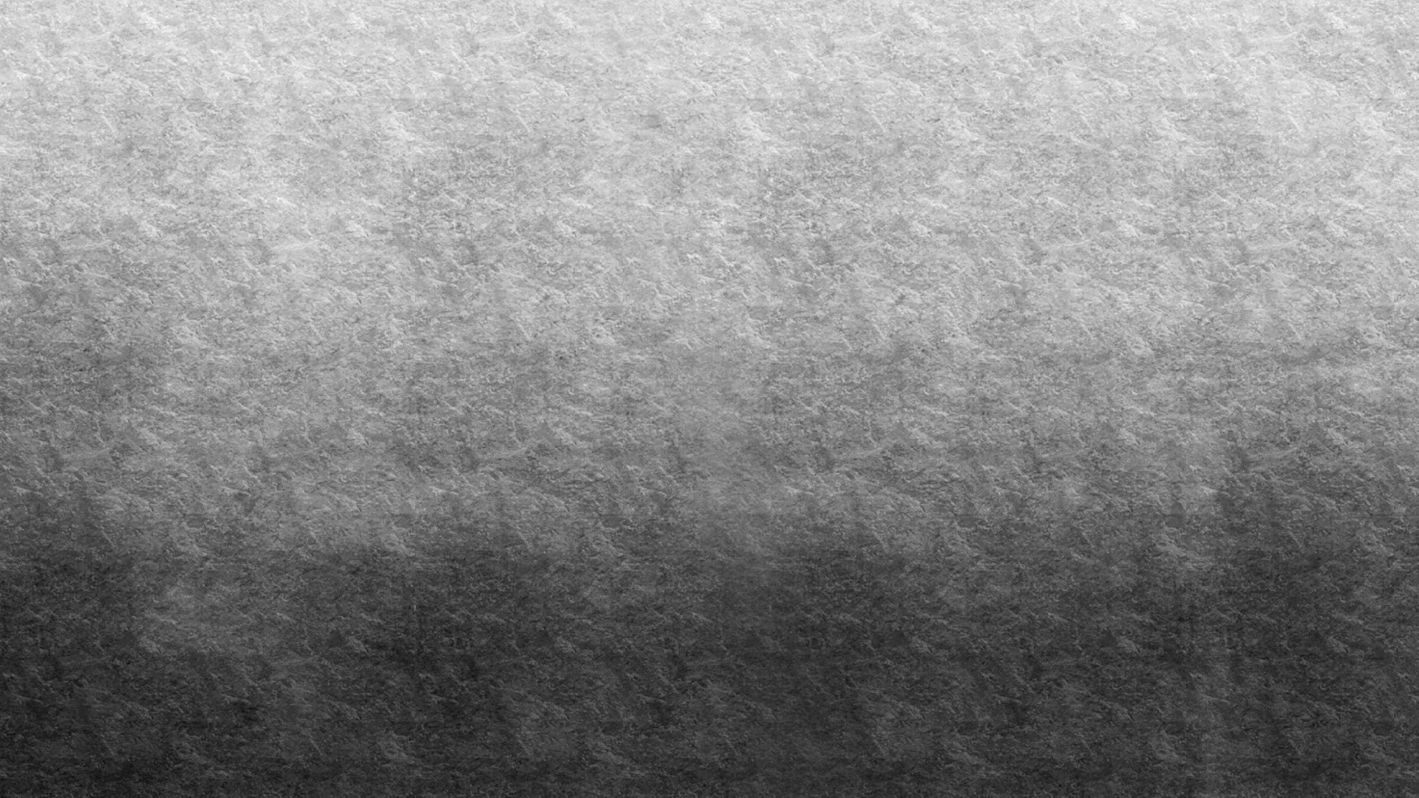

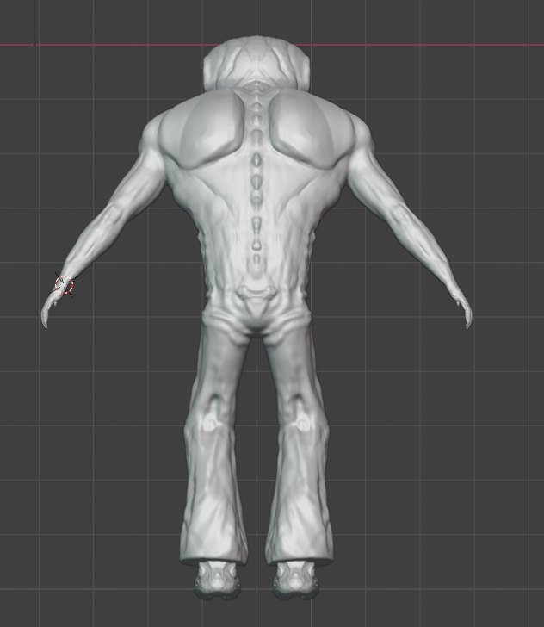
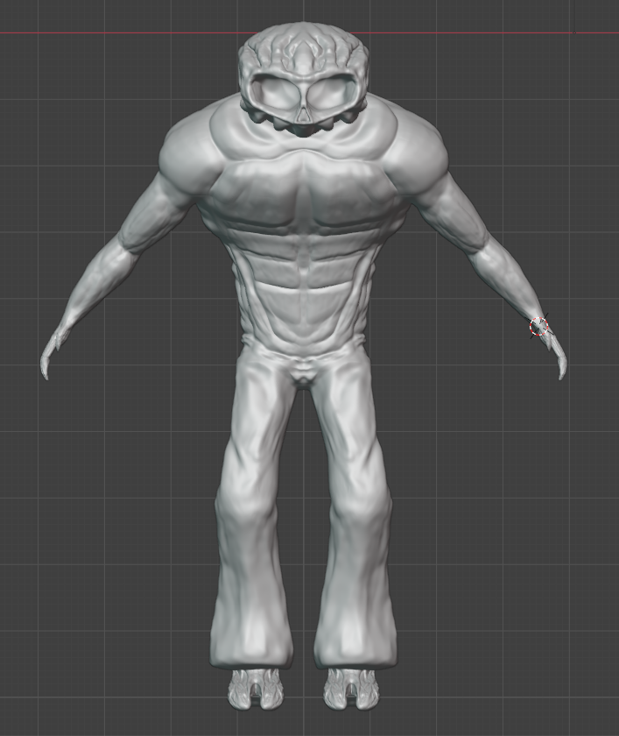
Sculpting
Holy smokes, I was kind of good at this.
I grew up around doctors and read human anatomy books for fun so I found it easy to do semi-realistic musculature

Slide 5
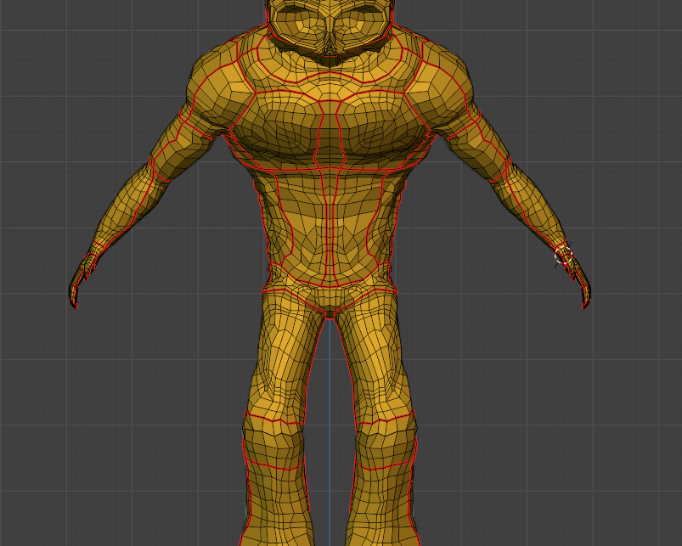
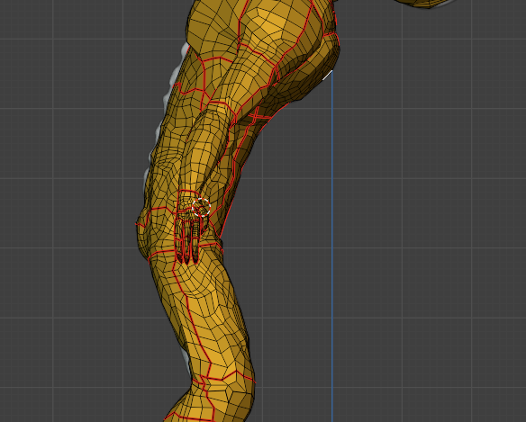
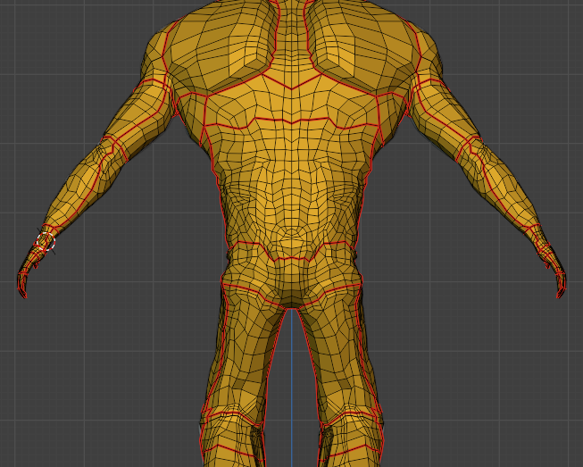
Retopology (Part 1)

Slide 6
Retopology (Part 2)
I don’t have images from this step, this slide is here to emphasize the fact I did my retopology three times.

Slide 7
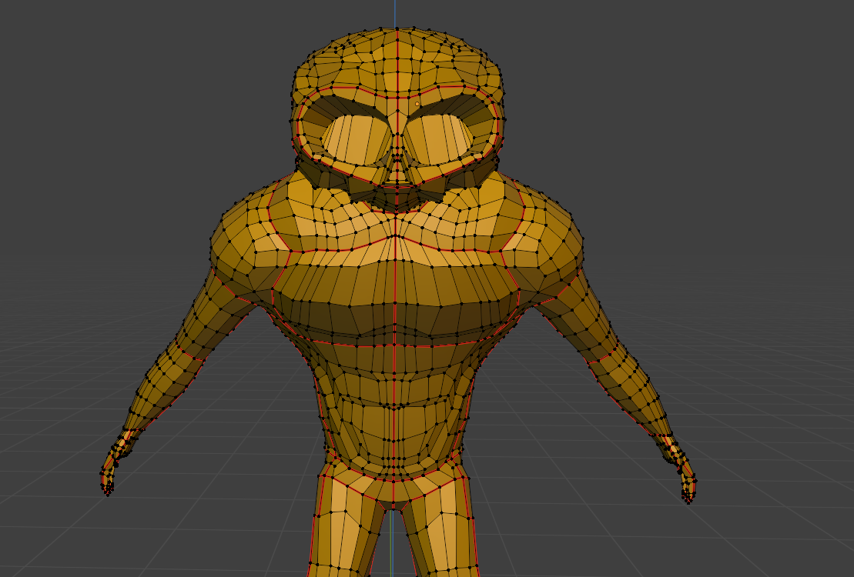
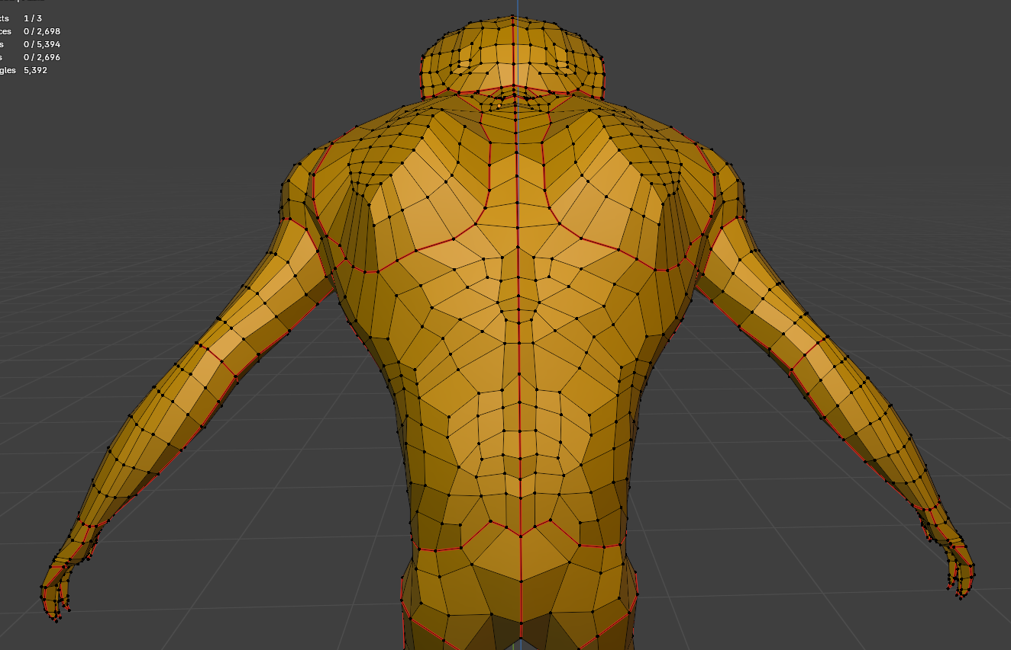
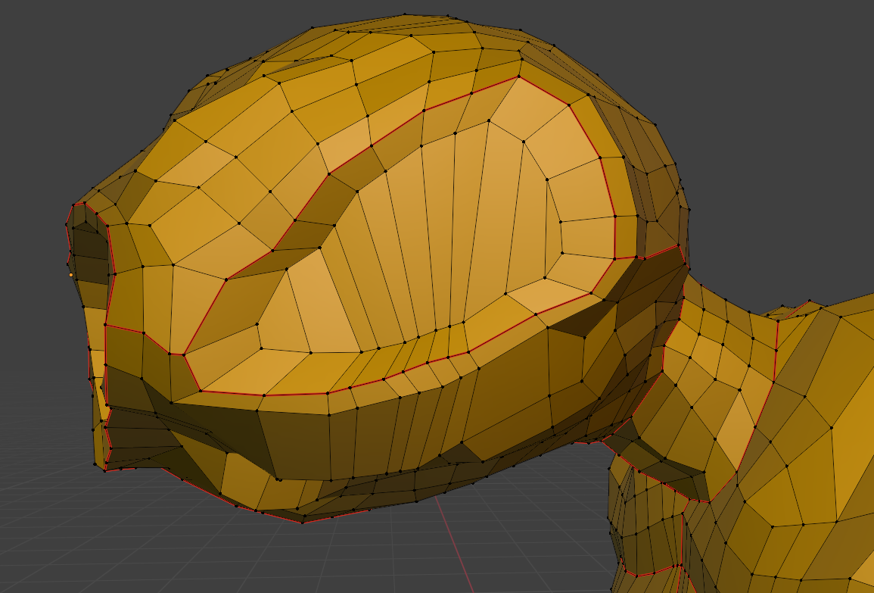
Retopology (Part 3)
I finally get it! I’m now a bad mama-jamma when it comes to retopology.

Slide 8

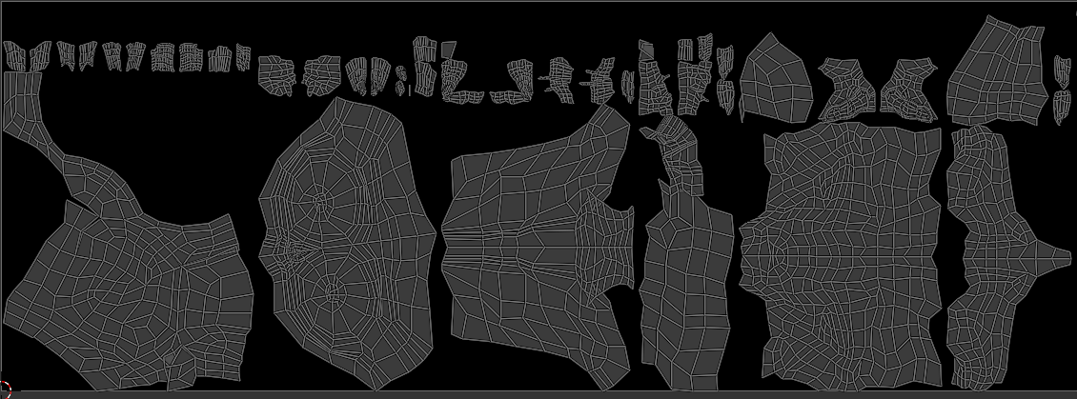
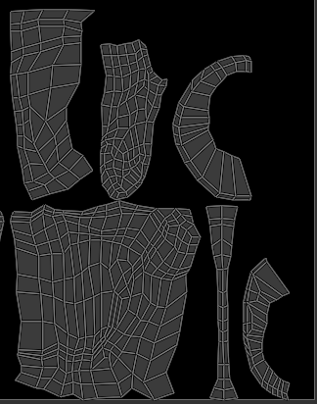
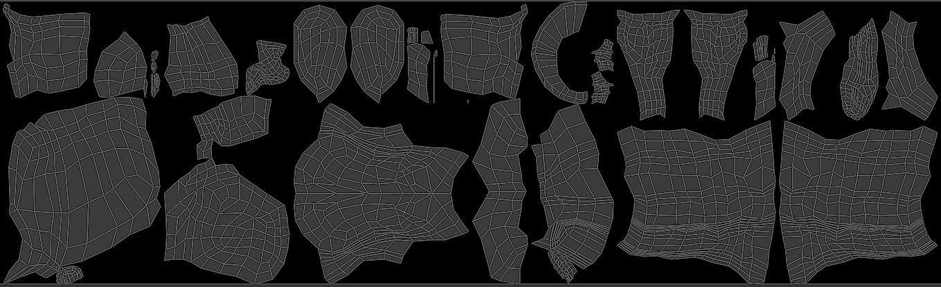
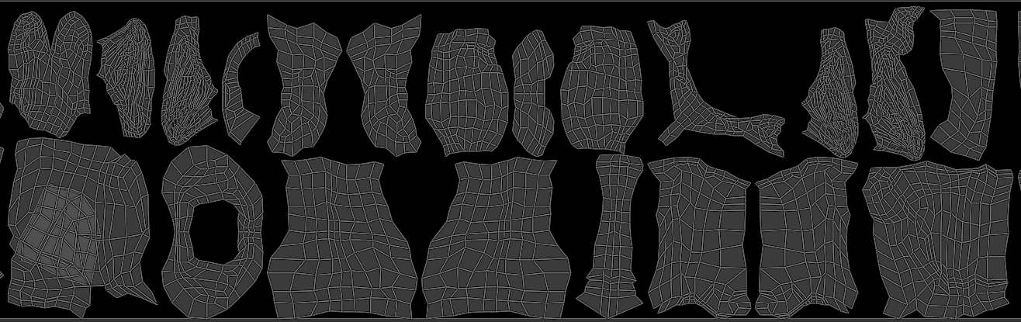
UV (Pile of Woe)

Slide 9
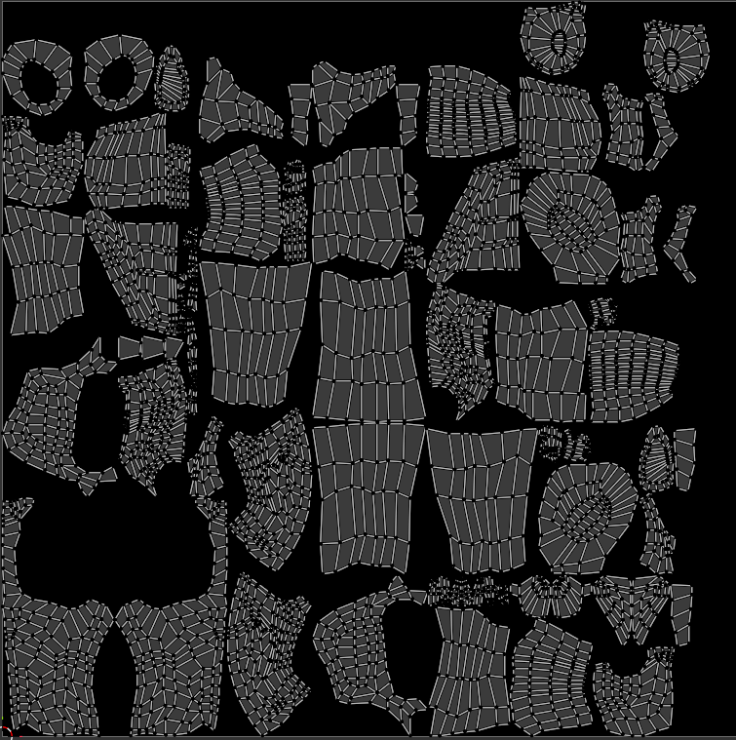
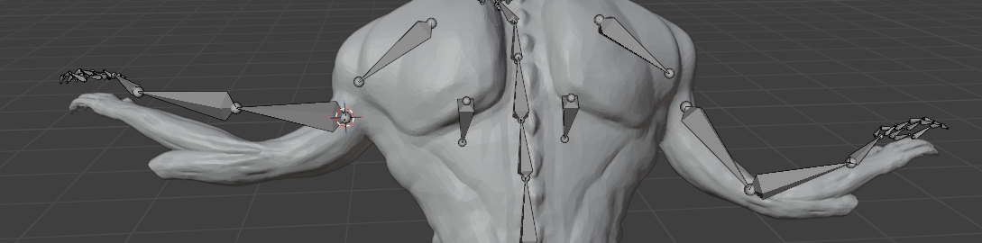
UV
I did it!
This is the result of a lot of manually removing errors in my sculpt and mesh, redoing and redoing my retopology, and a lot of frustration.
If you remember from my last presentation, the image below is what started a week of hell as I manually repaired my mesh from this.

Slide 10
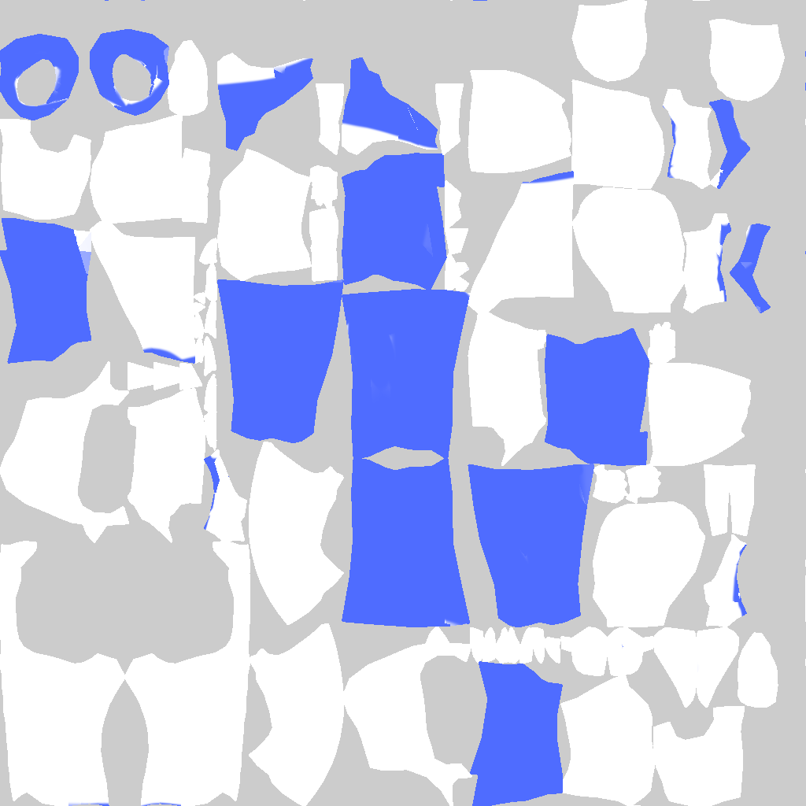
Texturing
I grasp texturing so poorly that after watching a tutorial about applying a denim texture to the legs of my model and working through it. I found out I had saved over my work with the blue paint I had used to mark my leg regions.

Slide 11
Animation
The following is my best attempt at manual rigging.
I do not understand animating in Blender well enough to know what the problem with my model is, the shoulders and chest are essentially immovable from one another, and I cannot figure out why.
I do not know where the orange tint on top of the video is coming from, I could not locate anything orange aside from the material color which did not alter it.

Slide 12
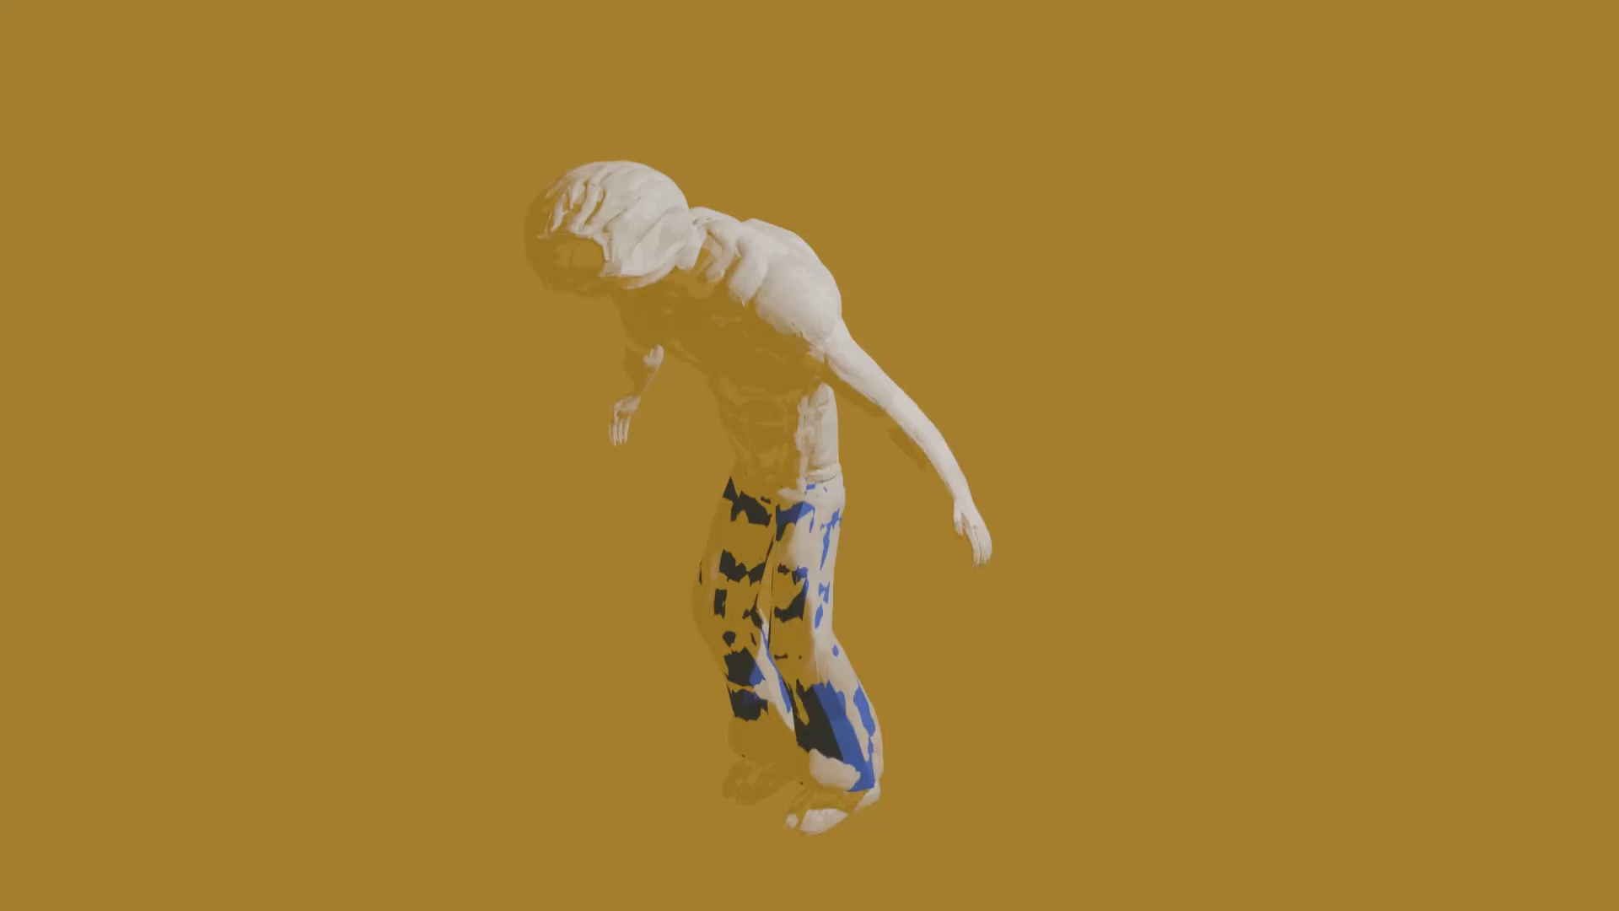

Slide 13
What I Learned and Where I Struggled
Triumphs:
Modeling
Sculpting
Retopology
Struggles:
Texturing
Animation
Despite what I consider a lackluster final product, I am very, very proud of what I accomplished in this class. I struggle immensely with any kind of creative work. If any of you have had the pleasure or misfortune of having Game Dev classes with me, you’ll know that I pretty much code background systems and barely even touch the Unity scene, that’s how divorced I am from visual or aesthetic things. I was the kid that hated coloring books growing up, so actually producing an artistic product of even this quality makes me feel pretty good.

